Slide 1
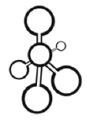
Data Structures
Lecture 20: Graphs

Slide 2
Graphs
A graph is a data structure that consists of a set of vertices (or nodes) and a set of edges (relations) between the pairs of vertices .
Undirected Graph
A
B
An undirected graph contains undirected edges (represented as lines) that allow you to travel in two ways.
D
E
C
V = {A, B, C, D, E}
E = { {A,B}, {A,D}, {C,E}, {D,E} }
Directed Graph
A directed graph is a graph that contains directed edges. Directed edges (represented as lines with an arrow on one end) are like one-way streets. They allow you to travel in one direction
A
B
D
E
C
E = { {A,B}, {B,A}, {B,E}, {D,A}, {E,A}, {E,C}, {E,D} }

Slide 3
Paths and Cycles (1)
A
B
A vertex is adjacent to another vertex if there is an edge to it from that other vertex (e.g. A is adjacent to D, but D is not adjacent to A)
D
E
C

Slide 4
Paths and Cycles (2)
Ann Arbor
50
260
40
60
Detroit
Cleveland
120
130
Pittsburgh
Chicago
Toledo
320
148
150
Fort
Wayne
155
180
Philadelphia
180
120
180
Indianapolis
Columbus
A path is a sequence of vertices in which each successive vertex is adjacent to its predecessor.
Example: Philadelphia  Pittsburg  Columbus  Indianapolis  Chicago
In a simple path (like the one shown), the vertices and edges are distinct, except that the first and last vertex may be the same.

Slide 5
Paths and Cycles (3)
Ann Arbor
50
260
40
60
Detroit
Cleveland
120
130
Pittsburgh
Chicago
Toledo
320
148
150
Fort
Wayne
155
180
Philadelphia
180
120
180
Indianapolis
Columbus
The highlighted path is not a simple path.

Slide 6
Paths and Cycles (4)
Ann Arbor
50
260
40
60
Detroit
Cleveland
120
130
Pittsburgh
Chicago
Toledo
320
148
150
Fort
Wayne
155
180
Philadelphia
180
120
180
Indianapolis
Columbus
A cycle is a simple path in which only the first and final vertices are the same.
Example: Pittsburgh  Columbus  Toledo  Cleveland  Pittsburgh

Slide 7



The Data Fields of the Edge Class
Data Field | Attribute
 | The destination vertex for an edge
 | The source vertex for an edge
 | The weight

Slide 8


The Constructors of the Edge Class
Constructor | Purpose
 | Constructs an Edge from source to dest. Sets the weight to w. If w is not specified, then the weight is set to 1.0.
 | Constructs an Edge that is a copy of other.
 | Constructs a dummy edge with source and dest set to -1 and weight to infinity.

Slide 9





The Functions of the Edge Class
Member Function | Behavior
 | Compares two edges for equality. Edges are equal if their source and destination vertices are the same. The weight is not considered.
 | Returns the destination vertex.
 | Returns the source vertex.
 | Returns the weight.
 | Returns a string representation of the edge.

Slide 10




The Abstract Graph Class (1)
The Data Fields
Data Field | Attribute
 | true if this is a directed graph.
 | The number of vertices.
The Constructors
Constructor | Purpose
 | Constructs an empty graph with the specified number of vertices (n) and with the specified directed flag (d). If directed is true, this is a directed graph.
 | The destructor

Slide 11


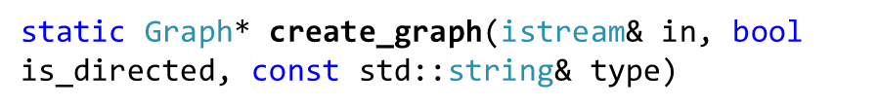
The Abstract Graph Class (2)
The Functions
Function | Behavior
 | Gets the number of vertices
 | Returns true if the graph is a directed graph
 | Loads edges from a data file.
 | Factory function to create a graph and load the data from an input of the specified type.

Slide 12
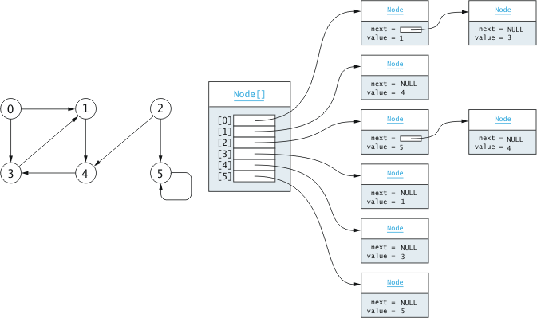
The List Graph (Directed)

Slide 13
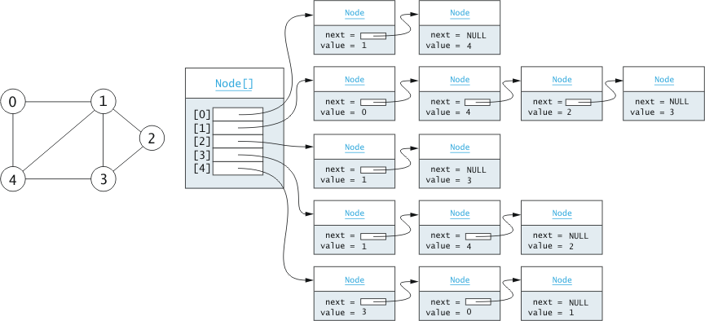
The List Graph (Undirected)

Slide 14


The List_Graph Class (1)
The Data Fields
Data Field | Attribute
 | A vector of lists to contain the edges that originate with each vertex.
The Constructors
Constructor | Purpose
 | Constructs a graph with the specified number of vertices and directionality.

Slide 15


The List_Graph Class (2)
The Functions
Function | Behavior
 | Returns an iterator to the edges that originate from a given vertex.
 | Gets the edge between two vertices.
 | Inserts a new edge into the graph
 | Determines whether an edge exists from vertex source to vertex dest.

Slide 16
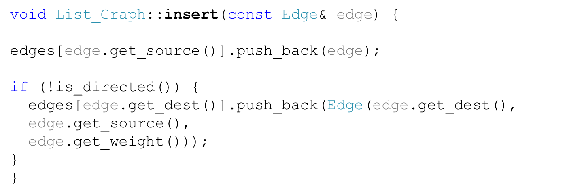

The insert Function

Slide 17
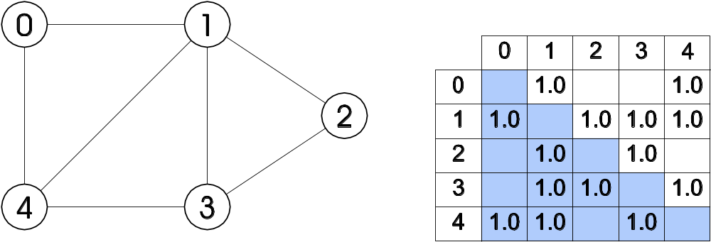
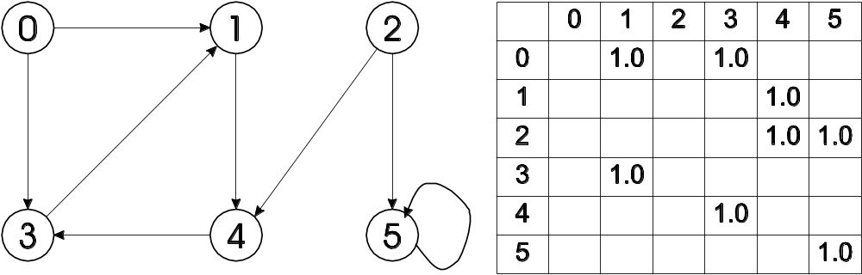
The Matrix Graph
Undirected
Directed

Slide 18
Breadth-First Search (Algorithm)
Take an arbitrary start vertex, mark it identified, and place it in a queue.
while the queue is not empty
Take a vertex, u, out of the queue and visit u
for all vertices, v, adjacent to this vertex, u
if v has not been identified or visited
Mark it identified
Insert vertex v into the queue
We are not finished visiting u
5
5
5
5
4
4
4
4
0
0
0
0
1
6
3
1
6
3
1
3
6
3
1
6
7
7
7
2
7
2
2
2
9
9
9
9
8
8
8
8
Queue
0
1
3
2
4
6
7
8
9
5
Identified
visited
being visited

Slide 19

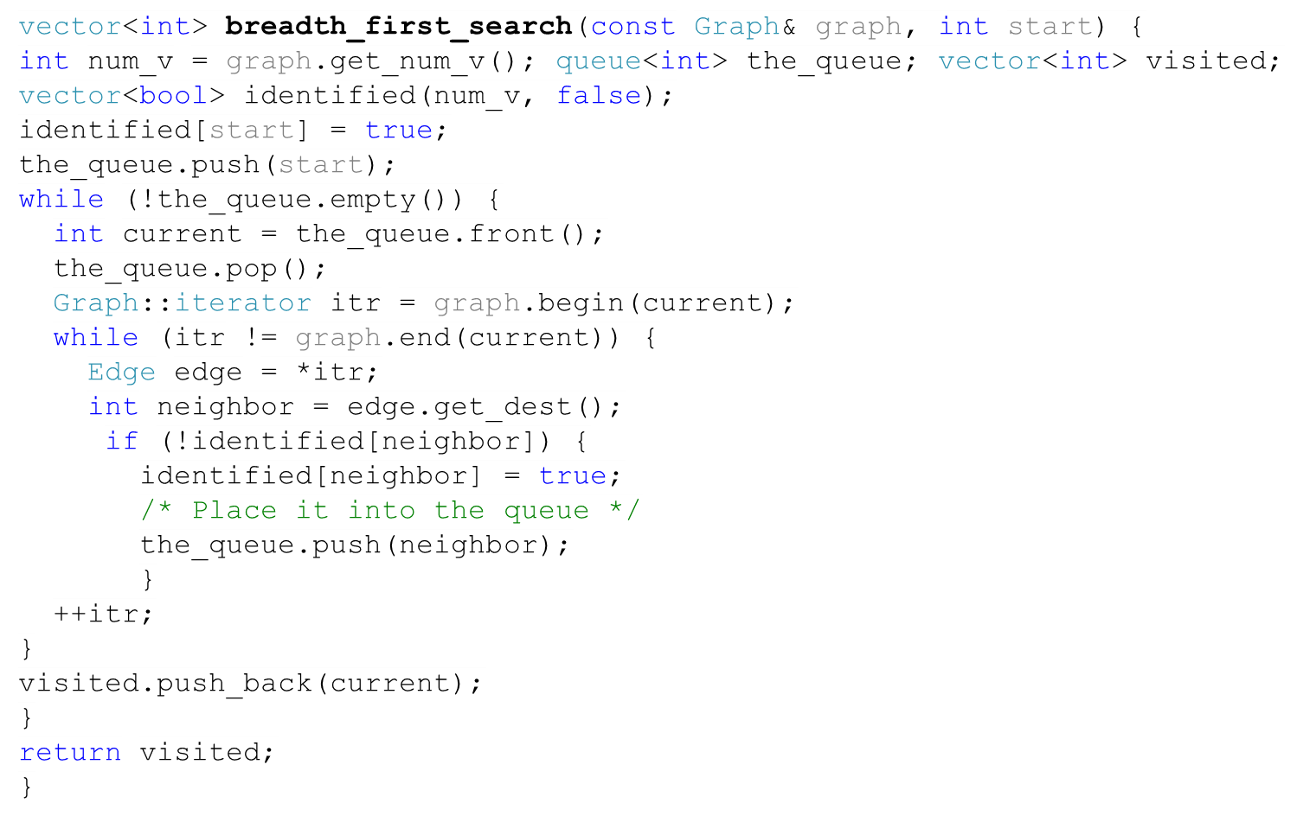
Breadth-First Search (Source Code)
5
5
5
5
4
4
4
4
0
0
0
0
1
6
3
1
6
3
1
3
6
3
1
6
7
7
7
2
7
2
2
2
9
9
9
9
8
8
8
8
Queue
0
1
3
2
4
6
7
8
9
5
Identified
visited
being visited

Slide 20
Depth-First Search
Mark the current vertex, u, identified
for each vertex, v, adjacent to the current vertex, u
if v has not been identified
Set parent of v to u
Recursively apply this algorithm starting at v.
Mark u finished, and enter u into the finish order list
0
0
0
2
2
1
2
1
1
5
6
6
4
5
6
3
5
3
4
3
4
Finish Order
4
3
1
6
5
2
0
identified
finished

Slide 21
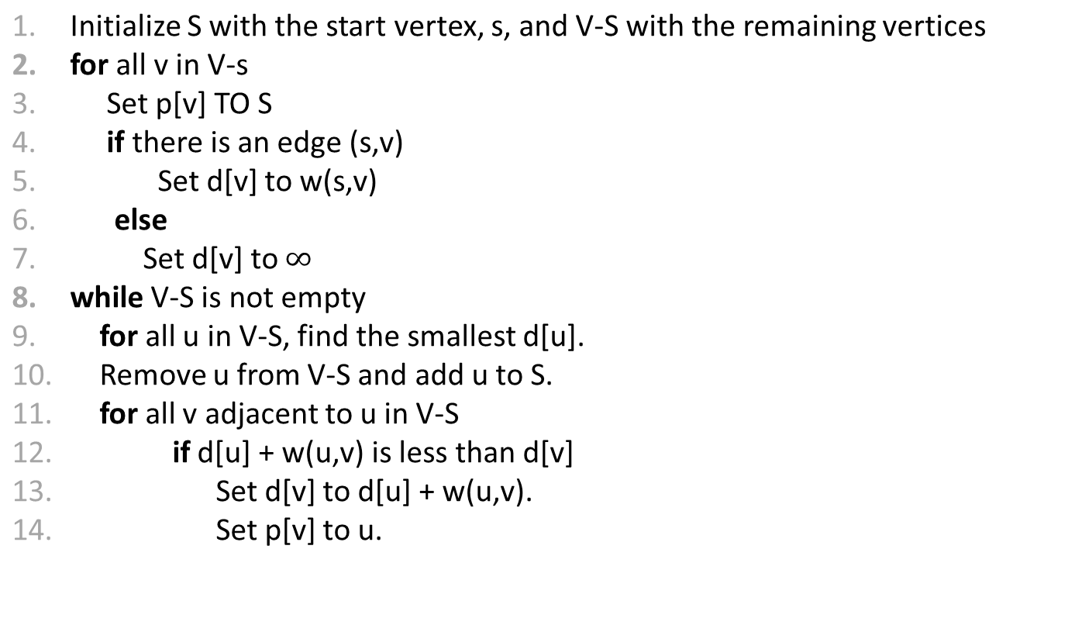
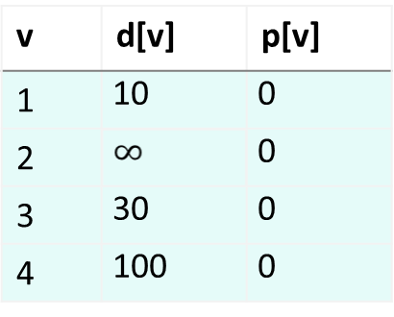
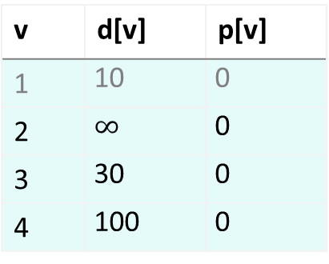
Finding the Shortest Path from a Vertex to All Other Vertices
Dijkstra’s Algorithm
0
100
10
30
4
1
60
50
10
60
1
3
2
20
v | d[v] | p[v]
1 | 10 | 0
2 | 60 | 1
3 | 30 | 0
4 | 100 | 0
v | d[v] | p[v]
1 | 10 | 0
2 | 50 | 3
3 | 30 | 0
4 | 90 | 3
50
3
90
3
60
2

